Slide 1
Developing with the SharePoint Framework: Web Parts
Exploring a SharePoint Framework Project

Slide 2

Exploring the SharePoint Framework API
SharePoint Framework utilities, indicators and libraries
Page modes
Page context
Environment types
Logging
Programmatically loading libraries
Notes:
In this unit, you'll learn about some of the features included in the SharePoint Framework API.

Slide 3
SPFx Utilities
SPFx includes many utility libraries that make developing SPFx components easier for developers
To use the utilities
Import the appropriate utility library (if necessary)
Call methods in the libraries
Notes:
The SharePoint Framework includes many utility APIs and libraries that make developing SharePoint Framework components easier. These utilities are available from the Framework API and from external libraries.

Slide 4
Status Renderers
Use when a web part is loading information from SharePoint or to display errors if a web part runs into issues that could prevent it from working properly
Available via the web part context property
Use the entire web part UX
Loading indicators
Useful when you are initializing or loading any content in your web part.
Error indicators
Used to display error messages.
Notes:
The first utility we'll cover is the status renderers. These indicators are ideal for use when you have an error to display or when your component is doing a long-running asynchronous operation.
The status renderers are available from the web part's `context` property so there's nothing to import or add to your project to use them. When used, the status renderer will take up the entire web part user experience. There are two types of renderers available to developers:
- **loading indicators**: used when initializing or loading content in your web part
- **error indicator**: used to display error messages

Slide 5
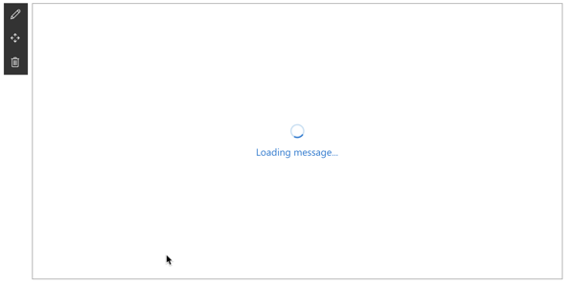
Loading Indicator
Display the loading indicator: displayLoadingIndicator()
Clear the loading indicator: clearLoadingIndicator()
this.context.statusRenderer.clearLoadingIndicator(this.domElement);
this.context.statusRenderer.displayLoadingIndicator(this.domElement, "message");
Notes:
Loading indicators are used when you need to initialize your web part and you want to provide some feedback to the user that something is happening. For example, a loading indicator can be shown when a web part is first added to the page, but needs to fetch information from Microsoft Graph, a remote API, when it first loads.
Instead of the user seeing a blank box on the page with no feedback that something is happening, you can show a loading indicator with an animated image and the message "Loading data.." to to user.
The two methods you'll use to control the indicator are `displayLoadingIndicator()` and `clearLoadingIndicator()`. Both methods are available from the `context` property on the web part.
The first parameter of both methods is the DOM element where the indicator should be placed. In this case, the indicator is taking up the entire area reserved for rendering the web part on the page.

Slide 6
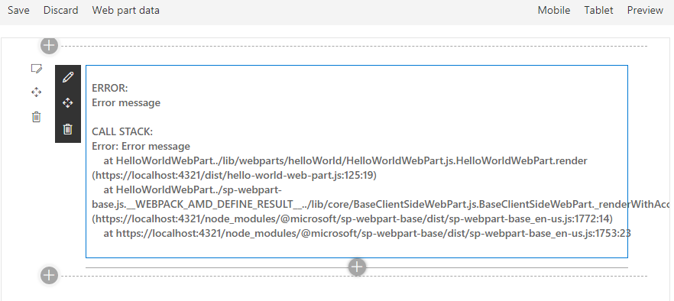
Error Indicator
Show an error, call renderError()
Clear an error, call clearError()
this.context.statusRenderer.renderError(this.domElement, err);
this.context.statusRenderer.clearError(this.domElement);
Notes:
Error indicators are used when you need to display errors to your users. They work the same way as loading indicators and are available from the `context` property on the web part.
Like the loading indicator, the first parameter of both methods is the DOM element where the indicator should be placed.

Slide 7
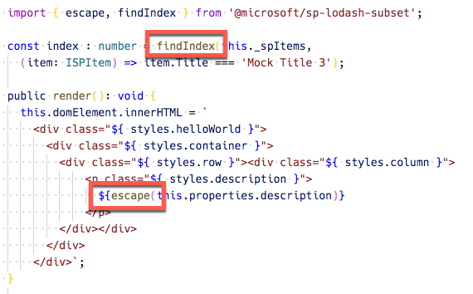
Lodash Utility Library
Use to perform operations on various objects like arrays, numbers, strings etc.
SharePoint Framework includes a subset of the lodash utility library:
https://lodash.com & https://www.npmjs.com/package/@microsoft/sp-lodash-subset
Notes:
Lodash is a great JavaScript utility library that you can use to perform operations on various objects such as arrays, numbers, and strings.
SharePoint Framework includes a repackage version of the the Lodash utility library that contains a subset of the most common and essential functions from larger Lodash to improve performance.
To use functions from the library, make sure you only import those functions that you will use in the current file. This will ensure you load only the minimally required code and not the entire Lodash subset library on the page:

Slide 8
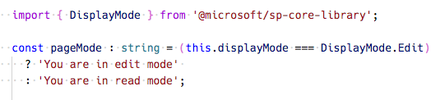
Page Display Modes
Classic Pages
Page and web part can be in different modes
Modern Pages
Page and web part are always in the same mode
Notes:
The SharePoint Framework API offers developers a way to determine the current display mode of a page. You can use this information to display a different experience for your users if the page is in read mode or edit mode.
To do this, use the `displayMode` property on the current component and compare it to one of the options on the enumeration `DisplayMode` available from the **@microsoft/sp-core-library** package:
> [!IMPORTANT]
> In a classic server-side SharePoint page, the web page and the web part can be in different modes. For example, the web page can be in edit mode while the web part is not in edit mode. In the modern client-side SharePoint page, both the page and/or its contents are in the same mode.

Slide 9
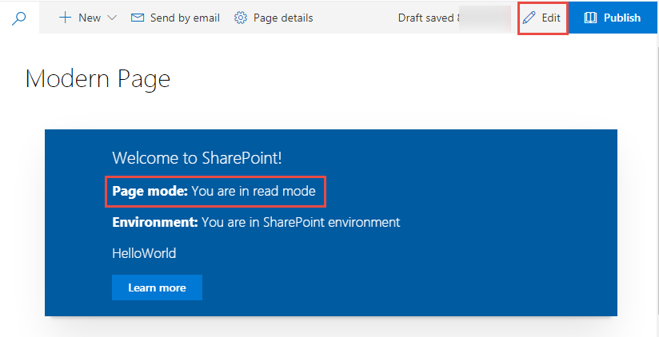
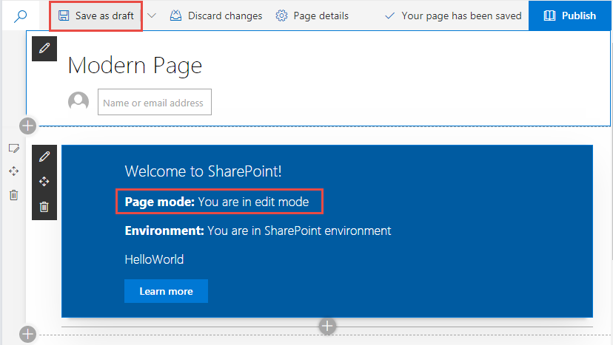
Page Display Modes – Modern Page
Notes:
While on a modern page, the display mode of the web part follows the same mode as the page.

Slide 10
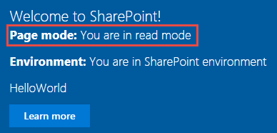
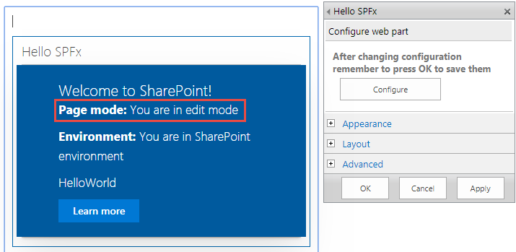
Page Display Modes – Classic Page
Page is not in Edit mode
Page is in Edit mode and the web part is in Edit mode
Page is in Edit mode and the web part is not in Edit mode
Notes:
Here you can see the difference between the different page modes when the previous code runs on a web part. In this example, the web part has been added to a classic page. Notice how the page's and web part's display mode don't always match up. This is because a web part can be in read or edit mode when the page is also in edit mode:

Slide 11
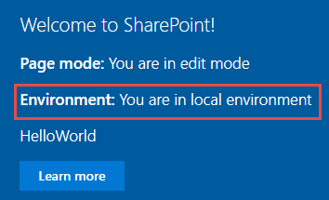
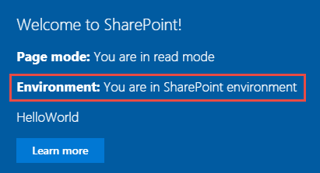
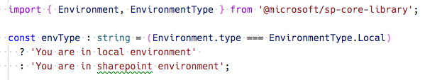
Environment Type
Web part running in the local Workbench
Web part running in the SharePoint Workbench in an Office 365 developer
Notes:
The following figure shows a web part running in the local workbench on the left, and another running in a real SharePoint environment on the right:

Slide 12
Page Context
Available with mock data in local Workbench
Fully available in SharePoint Workbench
Accessible Properties
Web title
Web absolute URL
Web server-relative URL
User login name
const siteTitle: string = this.context.pageContext.web.title;
Notes:
The SharePoint Framework API includes a reference to the context of the current page where the component is running. Use the `context` object, available from the component's base class, to access the page context:
Custom components can access the following properties on the page context:
- web title
- web absolute URL
- web server-relative URL
- current user login name
The `context` property is available in both the local workbench and SharePoint-hosted workbench. When testing a component in the local workbench, mock data is returned. For example, the title of the current site and details of the current user never change because they are hard-coded in the SharePoint Framework API.
The `context` property will always return real data when testing the component in the SharePoint-hosted workbench.

Slide 13
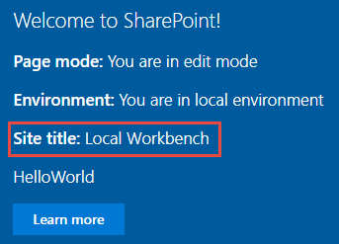
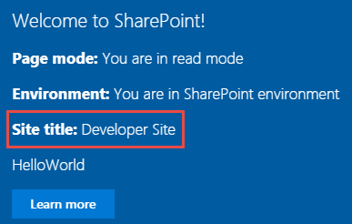
Page Context
Web part running in the local Workbench
Web part in the SharePoint Workbench, a modern, or a classic page
Notes:
Here's a web part running in the local workbench compared to running in the SharePoint-hosted workbench. Notice the local workbench version has a site title of **Local Workbench**.
In the other version of the web part, it's running in a real SharePoint page. This can be in the SharePoint-hosted workbench or on a web part page. Notice the title of the current site is different from the local workbench and will match the title of the site where the web part is currently running.

Slide 14
Logging
SPFx includes a built-in logging mechanism
All logging is output to the JavaScript console
Four static logging methods available
info : log information
warn : log warnings
error : log errors
verbose : log everything
The logging methods share the same signature
source: the source of the logging information (max 20 characters), such as the method or the class name
message: the actual message to log (max 100 characters)
scope: an optional service scope
The error method takes an Error object instead of a message string
Notes:
Logging is a very convenient and easy way to keep track of events happening in the web part. The SharePoint Framework has a built-in logging mechanism.
The `Log` class contains four static methods for logging:
- **info**: log information
- **warn**: log warnings
- **error**: log errors
- **verbose**: log everything
In the SharePoint Framework, all logging is written to the JavaScript console. You can see the logging messages using the developer tools in a web browser.
All static methods have the same signature, except the error method - they take three arguments:
- **source**: the source of the logging information (*max 20 characters*), such as the method or the class name
- **message**: the actual message to log (*max 100 characters*)
- **scope**: an optional service scope
The error method takes an `Error` object instead of the message string, otherwise they are the same.

Slide 15
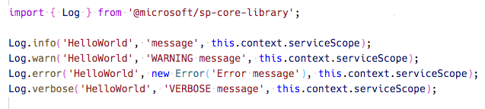
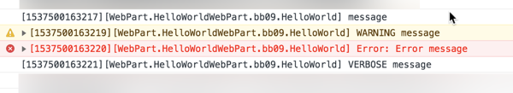
Logging
Notes:
To use the SharePoint Framework logging infrastructure, import the `Log` object from the **@microsoft/sp-core-library** package. Each of the methods will write a different type of logging message to the JavaScript console, as you can see here:

Slide 16
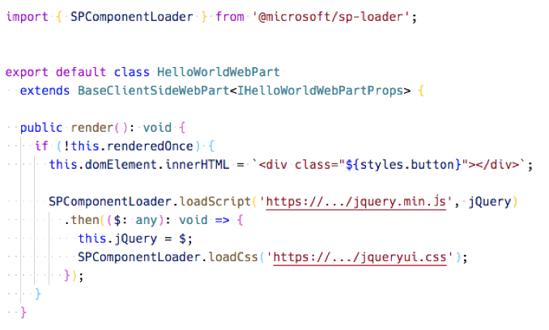
Loading scripts using SPComponentLoader
Notes:
When your component needs to programmatically load an external JavaScript or CSS file, you can use the `SPComponentLoader` object. This object can be found in the **@microsoft/sp-loader** package.
`SPComponentLoader` contains two methods: `loadScript()` and `loadCss()`. Both methods accept a string parameter of the URL of the file to load and return a JavaScript promise once the file has been loaded.
The `loadScript()` method accepts a second parameter that you can use to specify the object that the script should be assigned to when it is exported.
Notice how the `SPComponentLoader` is wrapped in the `if (!this.renderedOnce)` clause. The `render` function of client-side web parts is called initially whenever a web part is added to the page, but also every time a web part property is changed in the property pane. Because we only want to load the scripts with the `SPComponentLoader` one time, we use the `renderedOnce` property to verify that the web part is rendering initially and then load the required modules.
When loading jQuery using the `SPComponentLoader`, we load it as a global script associated with the `jQuery` variable.
Notice that after loading the jQuery library and before loading a CSS file for the jQuery UI project, we store the reference to jQuery in the `this.jQuery` variable.

Slide 17
Demo Exploring the SharePoint Framework API

Slide 18
Introducing the Property Pane
Overview of Web Part property pane
Implementing custom properties
Notes:
In this unit, you'll learn how to use the property pane in your SharePoint Framework client-side web part components.

Slide 19
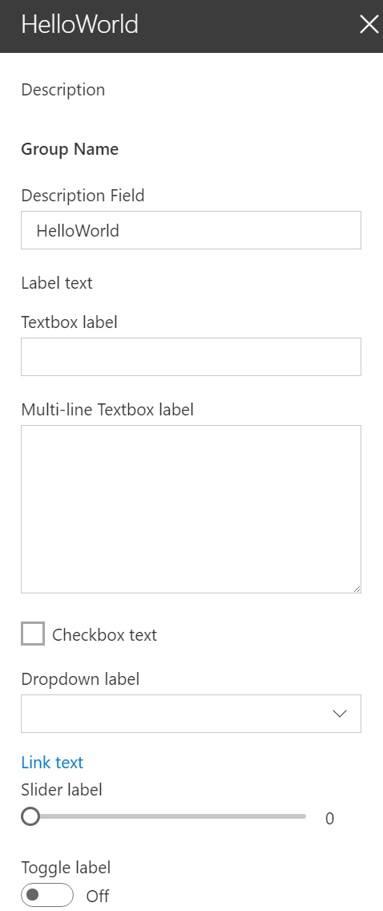
Overview
The property pane has three key elements
Pages, Headers, Groups
Property panes must contain a page and at least one group, the header is optional
Property pane supports the following field types out-of-the-box
Label
Textbox
Multi-line Textbox
Checkbox
Dropdown
Link
Slider
Toggle
Custom
Also possible to create your own custom field types
Notes:
The SharePoint Framework API for client-side web parts includes the following property pane field controls you can use in your custom web parts:
- label
- textbox
- checkbox
- dropdown
- link
- slider
- toggle
Developers can also create custom field controls for more complex scenarios. For example, maybe you want to implement a cascading dropdown where the selection of the first control impacts the available choices on the second selector.

Slide 20
Implementing properties
Define an interface in your web part that includes one or more target properties
Import the corresponding field types in the web part class
PropertyPaneXX field types are available as modules in the @microsoft/sp-webpart-base library
Modify the default getPropertyPaneConfiguration method and add the properties to the groupFields array
Notes:
Let's look at how you can implement custom properties on your web part and enable users to modify their values using the property pane.
The first step is to define the web part interface that's created as part of the web part creation process. This interface is located in the same file as the web part class. These properties will be mapped to specific field controls in your property pane.
Next, you need to import the field control objects into your web part's class. These controls are located in the **@microsoft/sp-webpart-base** package.
The last step is to add controls to the `groupFields` array in a group for a page returned in the `getPropertyPaneConfiguration()` method. The first argument in each control's reference is the name of the property it maps to.

Slide 21
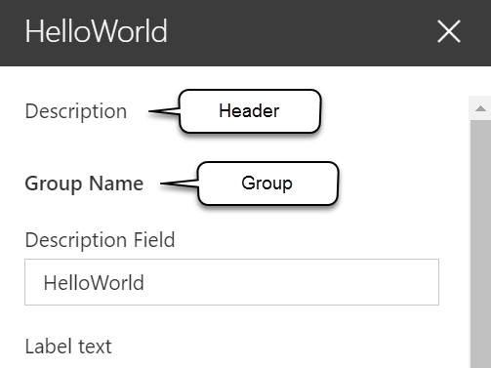
Implementing the header, groups, and fields
protected get getPropertyPaneConfiguration(): IPropertyPaneConfiguration {
return {
pages: [
{
header: {
description: strings.PropertyPaneDescription
},
groups: [
{
groupName: strings.BasicGroupName,
groupFields: [
PropertyPaneTextField('description', {
label: strings.DescriptionFieldLabel
}),
PropertyPaneLabel('labelField', {
text: 'Label text'
})
]
}
]
}
]
};
}
Notes:
The property pane is defined by your web part using a specific method. The SharePoint Framework will call the `getPropertyPaneConfiguration()` method on your web part to retrieve an object that implements the `IPropertyPaneConfiguration` interface.
The returned object contains a single property `pages` that returns an array of property pane pages:
Each page has an optional `header` property and a `groups` array. Each group can have a name and collection of fields assigned to it.
In the previous code, notice the single group has a name and a single text field control. This field control is mapped to the `description` property on the web part, defined in the web part's interface.

Slide 22
Handling property field changes
The property pane has two interaction modes:
Reactive
Non-reactive
Reactive mode: every change = change event is triggered
Reactive behavior automatically updates the web part user interface with the new property field values
Non-reactive mode: does not update the web part user interface automatically unless the user confirms the changes
While reactive mode is sufficient for many scenarios, at times you will need non-reactive behavior.
Notes:
The next step to customizing the property pane is to define how you want to handle changes to the properties in the property pane. The property pane has two different modes: **reactive** & **non-reactive**.
The default mode is reactive. In this mode, changes the value of the property pane controls are immediately applied to the associated properties of the web part.
In the non-reactive mode, changes to field controls are not immediately applied to the associated property of the control. Instead, the user must select the **Apply** button at the bottom of the property pane that is only rendered when the web part's property pane is in non-reactive mode.
> [!NOTE]
> The non-reactive mode of client-side web part property panes matches how legacy server-side web part property panes worked.

Slide 23

Property pane modes
Default mode = reactive mode
Override the default behavior by adding the disableReactivePropertyChanges method to the web part class
Notes:
To change the property pane from the default reactive mode to be non-reactive, you'll override a property on the web part's base class: `disableReactivePropertyChanges`. This property is set to `false` by default, but overriding it to return `true` will set the property pane to non-reactive.

Slide 24
Leverage the SPFx PnP Reusable Property Pane Controls
Overview Reusable PnP Controls
Leveraging PnP Controls
Notes:
In this unit, you'll learn how you can use third-party controls from the popular PnP SPFx reusable property pane controls project.

Slide 25

Why?
Property pane controls included in SharePoint Framework API are basic input controls
Textbox, drop downs, sliders, toggles, links, labels, etc…
Don’t contain logic or details about current SharePoint site
Simple controls developers can use in web parts
Developers can add logic to initialize them (populate dropdown list with the lists from current site) to create “smart controls”
Parker to the rescue! https://aka.ms/m365pnp
Notes:
The property pane field controls included in the SharePoint Framework API are basic input controls. They enable developers to provide users an experience to edit public properties on the web part. These basic controls don't contain any special logic or detail about the current SharePoint site.
For example, if you wanted to provide an experience for your users to select an existing SharePoint list from the current site from a list in the property pane, you'll have to write the code to retrieve all the SharePoint lists and display them in the property pane.
This common requirement could be simplified so that a developer could create a custom property pane field control that, when added to the property pane, contained the logic to retrieve all lists from the current SharePoint site and display them in a dropdown control. You could also include settings on the control to include or exclude hidden lists, exclude SharePoint infrastructure lists such as the Master Page Gallery or Client Side Assets library, or other settings.
These *smart controls* can then be used across multiple SharePoint Framework client-side web part projects, simplifying the code in those projects because they don't have to populate the property pane with a list of all SharePoint lists int he site.

Slide 26
Property Pane Controls for SPFx
Open source community library
Managed by the SharePoint Patterns & Practices(PnP) team
Includes reusable controls with logic tied to existing SharePoint site
https://sharepoint.github.io/sp-dev-fx-property-controls
Notes:
The SharePoint Patterns and Practices (PnP) group provides an open source library containing reusable controls for use in the SharePoint Framework client-side web part property pane. These controls include this reusable logic that is tied to the current SharePoint site.
You can learn more about these controls at **https://sharepoint.github.io/sp-dev-fx-property-controls**.

Slide 27


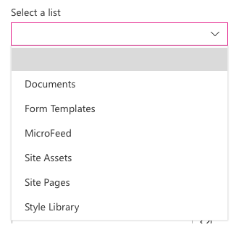
Popular Controls from the PnP Library
PropertyFieldColorPicker
Generates a color picker
PropertyFieldDateTimePicker
Create a datetime picker
PropertyFieldListPicker
Displays dropdown of lists from current SharePoint site
Supports single or multi-select
PropertyFieldPeoplePicker
Lists users & groups from the current SharePoint site
… and many more!
Notes:
This library contains multiple controls that you can use in your projects. Some of the controls include:
- **PropertyFieldColorPicker**: Select a color from a swatch or using the RGB values.
- **PropertyFieldDateTimePicker**: Select a date and time from a friendly picker control.
- **PropertyFieldListPicker**: Select a SharePoint list or lists from the current site.
- **PropertyFieldPeoplePicker**: Select people or groups from the current site's directory.

Slide 28
Adding to your project
// install as NPM package
npm install @pnp/spfx-property-controls --save --save-exact
// import reference in web part
import { PropertyFieldListPicker, PropertyFieldListPickerOrderBy } from '@pnp/spfx-property-controls/lib/PropertyFieldListPicker’;
// add to property pane configuration
PropertyFieldListPicker('lists', {
label: 'Select a list',
selectedList: this.properties.lists,
includeHidden: false,
orderBy: PropertyFieldListPickerOrderBy.Title,
disabled: false,
onPropertyChange: this.onPropertyPaneFieldChanged.bind(this),
properties: this.properties,
context: this.context,
onGetErrorMessage: null,
deferredValidationTime: 0,
key: 'listPickerFieldId'
})
Notes:
To use the PnP reusable property pane controls in your project, you start by first installing the NPM package that contains the controls:
Next, import only the controls into the web part file that you want to use.
> [!TIP]
> Ensure you only import the controls you want to use. When you import only specific objects, the bundling process will only include those objects and their dependencies in the resulting bundle. Otherwise, the entire library, including the controls you aren't using in your project, will be included in the bundle.
Finally, add the control to the list of `groupFields` in the `getPropertyPaneConfiguration()` method:

Slide 29
Demo Working with the Property pane Leveraging the SPFx PnP Reusable Property Pane Controls

Slide 30
Using React and Office UI Fabric React Components
Office UI Fabric
Fabric React
Adding Fabric React to SPFx Projects

Slide 31
What is the Office UI Fabric?
Built by Microsoft
All about styling instead of JavaScript
Integrates with other frameworks
Language support

Slide 32
Open Source
The Office UI Fabric project is developed and maintained by Microsoft in order to...
Help the development community build Office Add-ins and Office 365 web apps that integrate seamlessly with Office
Provide a point of reference for the evolving Office 365 design language that anyone can reference
Enable the community to contribute to better experiences for everyone who builds for Office

Slide 33
Monitor Releases and Contribute
Microsoft releases changes to the design language, components, and other assets frequently, and will make these updates available to the community.
If features are deprecated MS notes that in the change log, and the feature will be removed from the next major release.
Change Log
https://github.com/OfficeDev/Office-UI-Fabric/releases
Contribute In the GitHub Repository
https://github.com/OfficeDev/Office-UI-Fabric

Slide 34
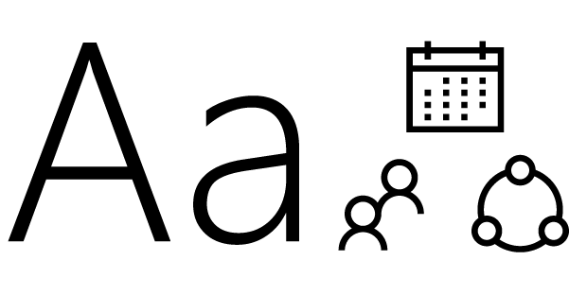
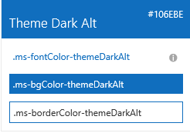



Fabric Core styling
Fonts and typography
Segoe font family + type ramp, official Office 365 iconography
Color
Official Office 365 color palette
Branded assets
Product symbols + product filetype symbols
Animations
Official Office 365 selection of easings and animations
Responsive grid
Tailored to Office 365 silhouettes
Notes:
When I talk about what we make available to developers, there are two broad categories: core and components
Core is the basic, fundamental elements of our design language that devs (MS devs included) can use to integrate apps, web parts, and custom solutions into Office/Office 365 and (of course) SP experiences

Slide 35
Styles
Office UI Fabric provides styles to allow you to implement the following things in your applications:
Typography
Color
Icons
Animations
Responsive Grid
Localization

Slide 36
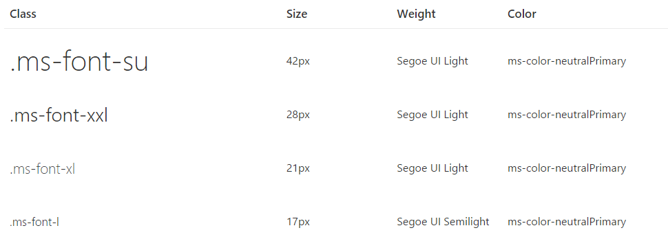
Typography
Base font classes
Fabric includes 10 base font classes that represent the type ramp for the Office Design Language. Each base class sets a default size, weight, and color.

Slide 37
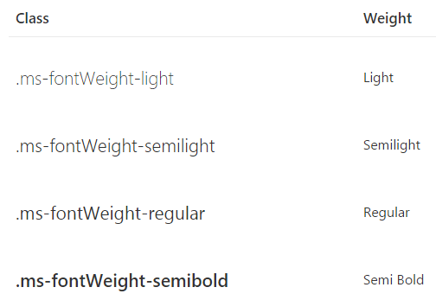
Typography
Helper font classes
Use one of several helper font classes to change the text weight

Slide 38
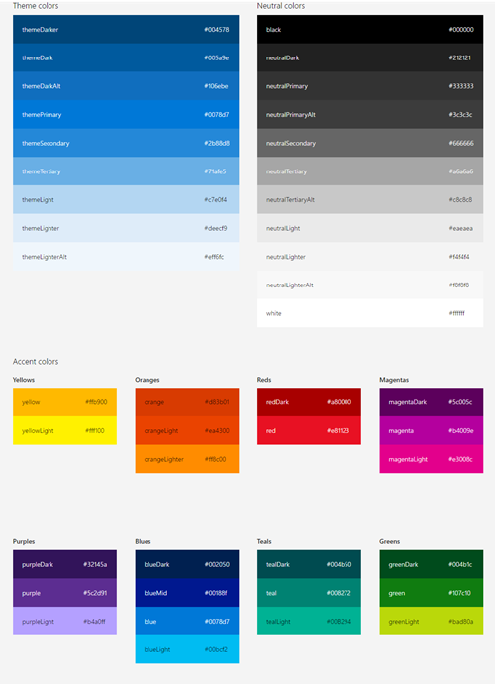
Color
Includes 9 theme colors and 11 neutral colors
Each has helper classes for text, border, background, and hover states
These color classes act as hooks into the Office 365 suite-wide theming system
When the theming system is enabled and your app or Add-in is consuming the suite navigation, these classes pick up the user's chosen theme

Slide 39
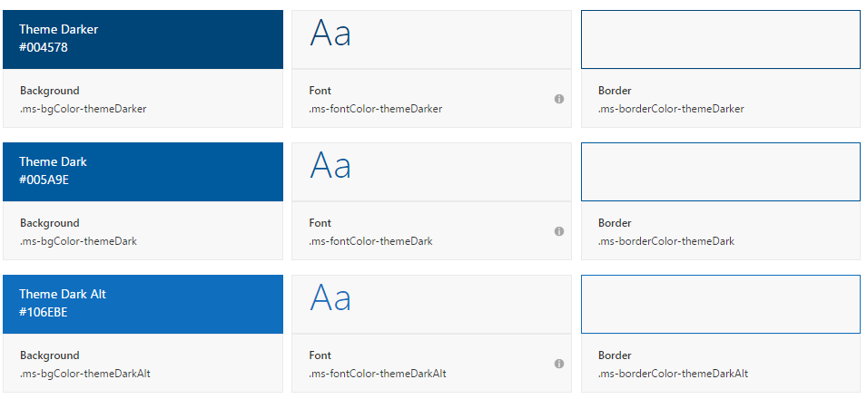
Color
Theme colors
Use theme colors in wayfinding, navigation, and key interactions like primary actions and current or selected indicators

Slide 40
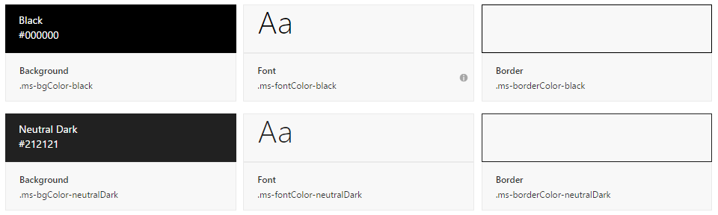
Color
Neutral Colors
Neutral colors include black, gray, and white. Use darker shades of gray for primary content, such as text and titles
Use black sparingly for high-impact strings (labels, names) and hover states
Use lighter shades of gray for supporting graphic elements and page areas

Slide 41
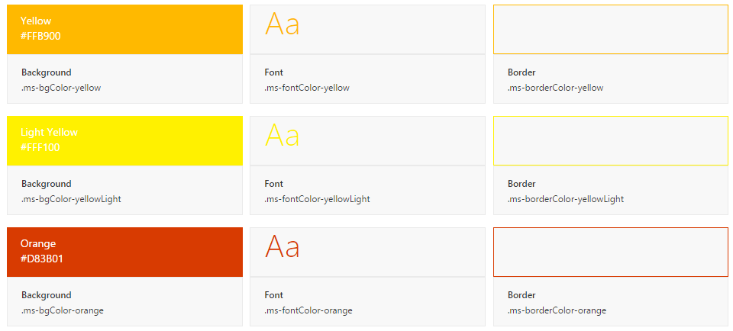
Color
Accent Colors
Fabric also includes accent colors from the Microsoft color palette

Slide 42
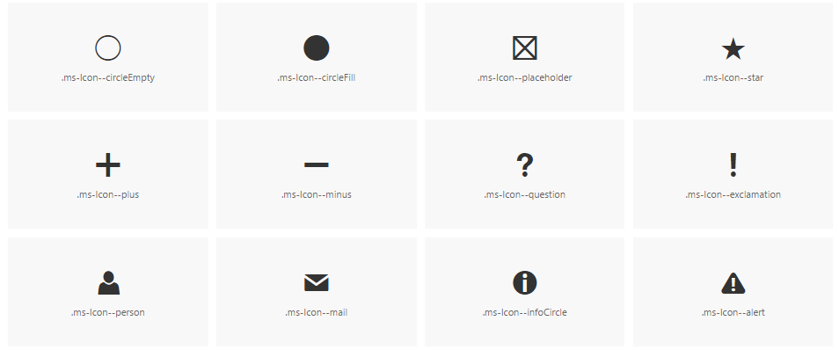
Icons
Fabric uses a custom font for its iconography
Font contains glyphs that you can scale, color, and style in any way
You can even flip them for right-to-left localization

Slide 43
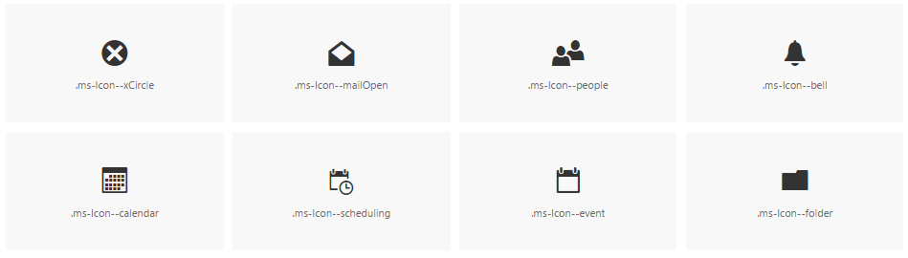
Icons
To use the icons, combine the base ms-Icon class with a modifier class for the specific icon.
<i class="ms-Icon ms-Icon--mail" aria-hidden="true"></i>
Note the aria-hidden attribute, which prevents screen readers from reading the icon. In cases where meaning is conveyed only through the icon, such as an icon-only navigation bar, be sure to apply an aria-label to the button for accessibility.

Slide 44

Side panel animations
When choosing a motion for side panels, consider the origin of the triggering element
Use the motion to create a link between the action and the resulting UI
For example, if the triggering element is on the right side of the interface, consider having the panel move in from the right

Slide 45

Dialog animations
When choosing a motion for dialogs, consider the origin and tone of the content
For a warning or error dialog, a quick fade in might be appropriate
If the dialog appears when a user chooses an item to get more information, a scale-up might be appropriate

Slide 46
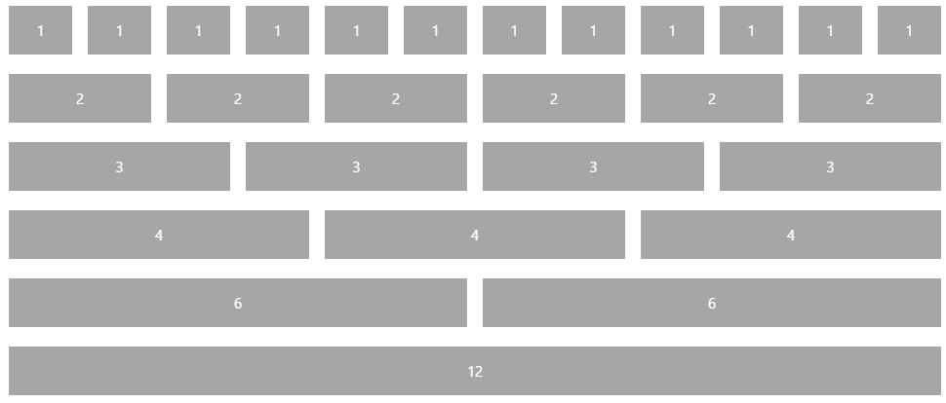
Responsive Grid
Fabric comes with a mobile-first, 12-column, responsive grid that you can use to create flexible layouts for a variety of screen sizes and device types

Slide 47
Localization
Right-to-left support
Fabric comes with an alternate CSS file for pages written in right-to-left (RTL) languages, such as Arabic and Hebrew
This reverses the order of columns in the responsive grid, making it easy to create an RTL layout without writing additional templates
Future versions of Fabric will also reverse some icons and provide additional helper utilities

Slide 48
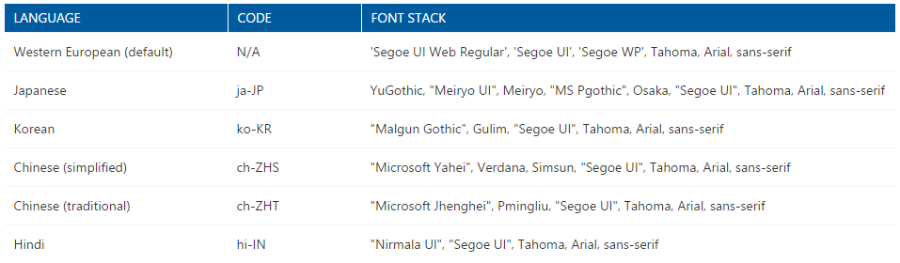
Localization
Language-optimized fonts
By default, Fabric presents all text using the Western European character set of Segoe UI
For languages with other characters, Fabric will either serve a version of Segoe UI with a different character set or use a system font
Fabric supports many language codes, which utilize different font stacks

Slide 49
React 101 & Basic React Web Part Structure
React 101
How to create a React web part
Structure of the basic template

Slide 50
Steps to design and build React based web parts
Component design
Splitting UIs
Designing flows and communications

Slide 51
React Design Principles
Components written by different people should work well together
Add functionality to a component without causing rippling changes throughout the codebase
Use state and lifecycle hooks in moderation
Components describe any composable behavior
Rendering
Lifecycle
State
Notes:
The key feature of React is composition of components. Components written by different people should work well together.
Add functionality to a component without causing rippling changes throughout the codebase.
For example, it should be possible to introduce some local state into a component without changing any of the components using it. Similarly, it should be possible to add some initialization and teardown code to any component when necessary.
There is nothing "bad" about using state or lifecycle hooks in components. Like any powerful features, they should be used in moderation.
In React, components describe any composable behavior, and this includes rendering, lifecycle, and state.

Slide 52
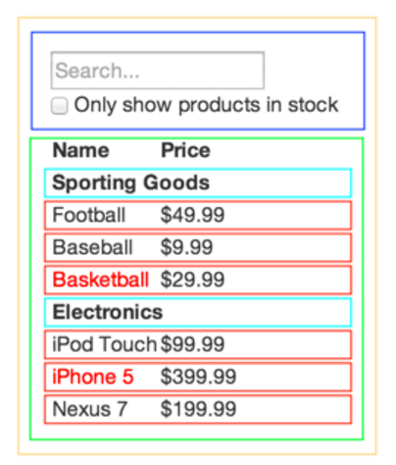
Break The UI Into A Component Hierarchy
Draw boxes around components and name them
Use the single responsibility principle: component only do one thing
UI and data models tend to adhere to the same information architecture
Create components that represent exactly one piece of your data model
Arrange components into a hierarchy
FilterableProductTable (orange): contains the entirety of the example
SearchBar (blue): receives all user input
ProductTable (green): displays and filters the data collection based on user input
ProductCategoryRow (turquoise): displays a heading for each category
ProductRow (red): displays a row for each product
Notes:
https://facebook.github.io/react/docs/thinking-in-react.html
The first thing you'll want to do is to draw boxes around every component (and subcomponent) in the mock and give them all names. If you're working with a designer, they may have already done this, so go talk to them! Their Photoshop layer names may end up being the names of your React components!
But how do you know what should be its own component? Just use the same techniques for deciding if you should create a new function or object. One such technique is the single responsibility principle, that is, a component should ideally only do one thing. If it ends up growing, it should be decomposed into smaller subcomponents.
Since you're often displaying a JSON data model to a user, you'll find that if your model was built correctly, your UI (and therefore your component structure) will map nicely. That's because UI and data models tend to adhere to the same information architecture, which means the work of separating your UI into components is often trivial. Just break it up into components that represent exactly one piece of your data model.
You'll see here that we have five components in our simple app. We've italicized the data each component represents.
FilterableProductTable (orange): contains the entirety of the example
SearchBar (blue): receives all user input
ProductTable (green): displays and filters the data collection based on user input
ProductCategoryRow (turquoise): displays a heading for each category
ProductRow (red): displays a row for each product
If you look at ProductTable, you'll see that the table header (containing the "Name" and "Price" labels) isn't its own component. This is a matter of preference, and there's an argument to be made either way. For this example, we left it as part of ProductTablebecause it is part of rendering the data collection which is ProductTable's responsibility. However, if this header grows to be complex (i.e. if we were to add affordances for sorting), it would certainly make sense to make this its own ProductTableHeader component.
Now that we've identified the components in our mock, let's arrange them into a hierarchy. This is easy. Components that appear within another component in the mock should appear as a child in the hierarchy:
FilterableProductTable
SearchBar
ProductTable
ProductCategoryRow
ProductRow

Slide 53
Build A Static Version in React
Build a version that takes your data model and renders the UI but has no interactivity
Build components that reuse other components and pass data using props, don't use state at all to build this static version
The component at the top of the hierarchy (FilterableProductTable) will take your data model as a prop
class ProductCategoryRow extends React.Component { render() { return <tr><th colSpan="2">{this.props.category}</th></tr>; } } class ProductRow extends React.Component { render() { var name = this.props.product.stocked ? this.props.product.name : <span style={{color: 'red'}}> {this.props.product.name} </span>; return ( <tr> <td>{name}</td> <td>{this.props.product.price}</td> </tr> ); } }
Notes:
https://facebook.github.io/react/docs/thinking-in-react.html
Now that you have your component hierarchy, it's time to implement your app. The easiest way is to build a version that takes your data model and renders the UI but has no interactivity. It's best to decouple these processes because building a static version requires a lot of typing and no thinking, and adding interactivity requires a lot of thinking and not a lot of typing. We'll see why.
To build a static version of your app that renders your data model, you'll want to build components that reuse other components and pass data using props. props are a way of passing data from parent to child. If you're familiar with the concept of state, don't use state at all to build this static version. State is reserved only for interactivity, that is, data that changes over time. Since this is a static version of the app, you don't need it.
You can build top-down or bottom-up. That is, you can either start with building the components higher up in the hierarchy (i.e. starting with FilterableProductTable) or with the ones lower in it (ProductRow). In simpler examples, it's usually easier to go top-down, and on larger projects, it's easier to go bottom-up and write tests as you build.
At the end of this step, you'll have a library of reusable components that render your data model. The components will only have render() methods since this is a static version of your app. The component at the top of the hierarchy (FilterableProductTable) will take your data model as a prop. If you make a change to your underlying data model and call ReactDOM.render() again, the UI will be updated. It's easy to see how your UI is updated and where to make changes since there's nothing complicated going on. React's one-way data flow (also called one-way binding) keeps everything modular and fast.
Simply refer to the React docs if you need help executing this step.

Slide 54
React Components Are Dynamic
Properties
Public settings on components
Similar to HTML element attributes
Use to provide values into component
Use to publish events to consumers
Defined on the component via TypeScript interfaces
State
State object of a component is a special property bag
React detects when the state changes & triggers a (re)render of the component
Change the state using the component’s setState() method
Defined on the component via TypeScript interfaces

Slide 55
Adding configuration properties to React Client-Side web parts
Pass the property value to React component when the React component is created
public render(): void {
const element: React.ReactElement<IHelloWorldWebPartProps> = React.createElement(
HelloWorldComponent, {
description: this.properties.description
});
ReactDom.render(element, this.domElement);
}
Notes:
Let's start with a simple React client-side web part. The properties on the web part, in this case the `description` property is set on the public property of the React control.

Slide 56
Adding configuration properties to React Client-Side web parts
Handle the property values in the React component when the component starts and whenever the property value is updated
public componentDidMount(): void {
this.doSomething(this.props.description);
}
public componentDidUpdate(prevProps: IHelloWorldWebPartProps, prevState: IHelloWorldWebPartState): void {
if (this.props.description !== prevProps.description) {
this.doSomething(this.props.description);
}
}
private doSomething(description: string): void {
// Do something with the property
}
Notes:
Within the React control, implement two React lifecycle event handlers. The method `componentDidMount()` is called when the control is initially loaded on the page, while the `componentDidUpdate()` is called when the properties on the component change. In this case, both methods will call the `doSomething()` method that will handle the property's value:

Slide 57
Component Properties
export interface IColorListProps {
colors: IColor[];
}
export class ColorList extends React.Component<IColorListProps, {}> {
public render(): React.ReactElement<IColorListProps> {
return (
<ul>
{
this.props.colors.map(colorItem => (
<li>{ colorItem.title }</li>
))
}
</ul>
);
}
}
<ColorList colors={this._colors} />

Slide 58
Component Properties to Publish Events
export type RemoveColorCallback = (color: IColor) => void;
export interface IColorListProps {
colors: IColor[];
onRemoveColor: RemoveColorCallback;
}
export class ColorList extends React.Component<IColorListProps, {}> {
public render(): React.ReactElement<IColorListProps> {
return ({
this.props.colors.map(colorItem => (
<button value={colorItem.title} onClick={() => this._onButtonClick(colorItem)} />
))
});
}
}
private _onButtonClick(color:IColor): void {
this.props.onRemoveColor(color);
}
<ColorList colors={this._colors} onRemoveColor={ this._removeColor } />

Slide 59
Component State
export interface IReactWebPartDemoState {
colors: IColor[];
}
export default class ReactWebPartDemo extends React.Component<IReactWebPartDemoProps, IReactWebPartDemoState> {
constructor(props: IReactWebPartDemoProps) {
super(props);
this.state = { colors: [] };
}
public render(): React.ReactElement<IReactWebPartDemoProps> {
return (
<ColorList colors={ this.state.colors } onRemoveColor={ this._removeColor } />
);
}
private _removeColor = (colorToRemove: IColor): void => {
const newColors = this.state.colors.filter(color => color != colorToRemove);
this.setState({ colors: newColors });
}
}

Slide 60
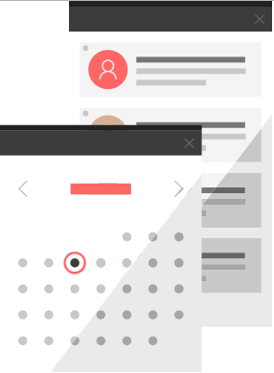
Fabric React: Office UI Fabric Components
Fabric's components make up the building blocks of your UI and are meant to be consumed as CSS applied to your markup
All JavaScript is presentational to explain behavior
Download the components from the GitHub repository
https://github.com/OfficeDev/Office-UI-Fabric

Slide 61
Using Fabric React Controls
Don’t import the entire Fabric React library; only import the control:
import { List } from 'office-ui-fabric-react/lib/List’;
Leverage the control within your React control:
public render(): React.ReactElement<IColorListProps> {
return (
<div>
<List items={ this.props.colors }
onRenderCell={ this._onRenderListCell } />
</div>
);
}

Slide 62
Demo First React webpart Leveraging Fabric React in SPFx Projects

